Slide 1
Beyond Mendel
Chapter 14 (p.271-281)
Chapter 15 (p.286-302)

Slide 2
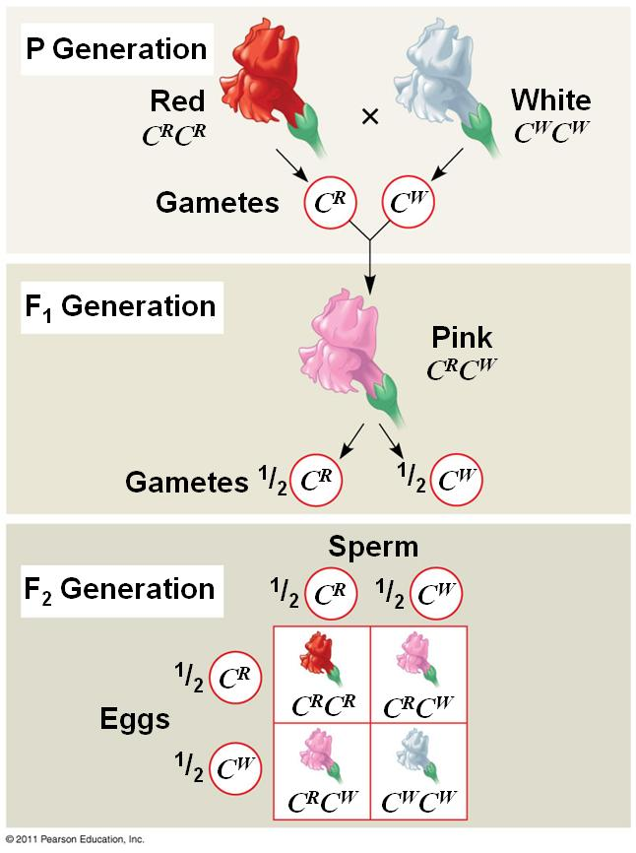
Incomplete Dominance

Slide 3
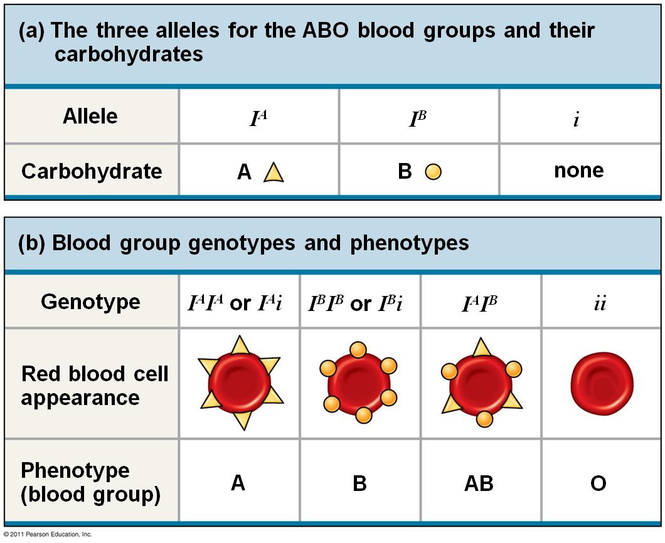
Codominance/Multiple Alleles

Slide 4
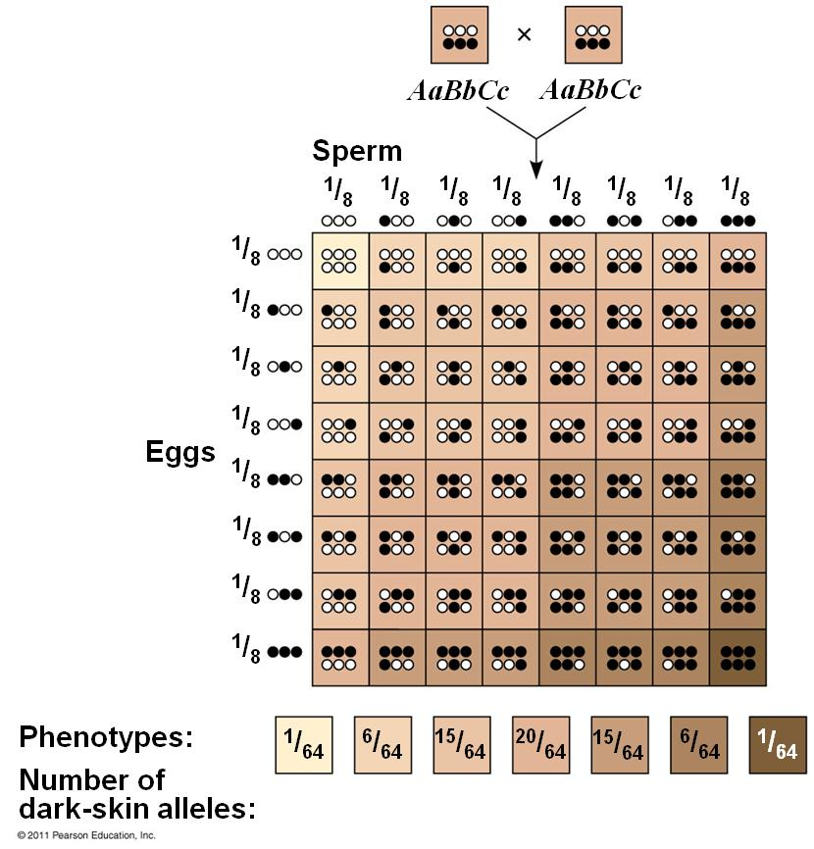
Polygenic Traits

Slide 5
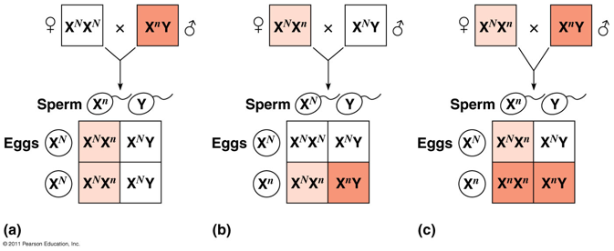
Sex(X)-Linkage

Slide 6
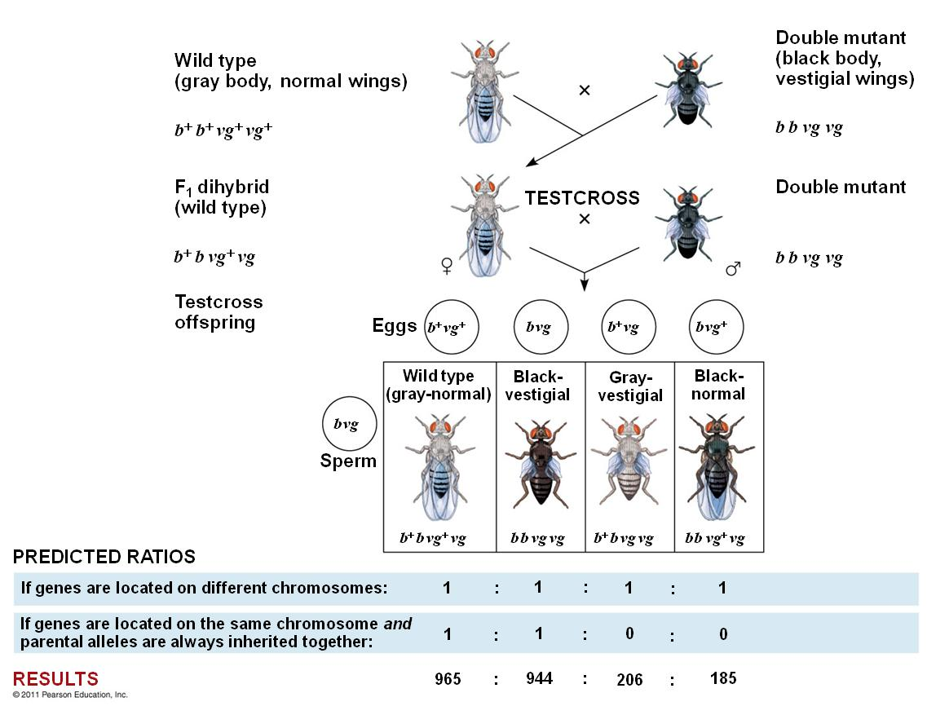
Linked Genes

Slide 7
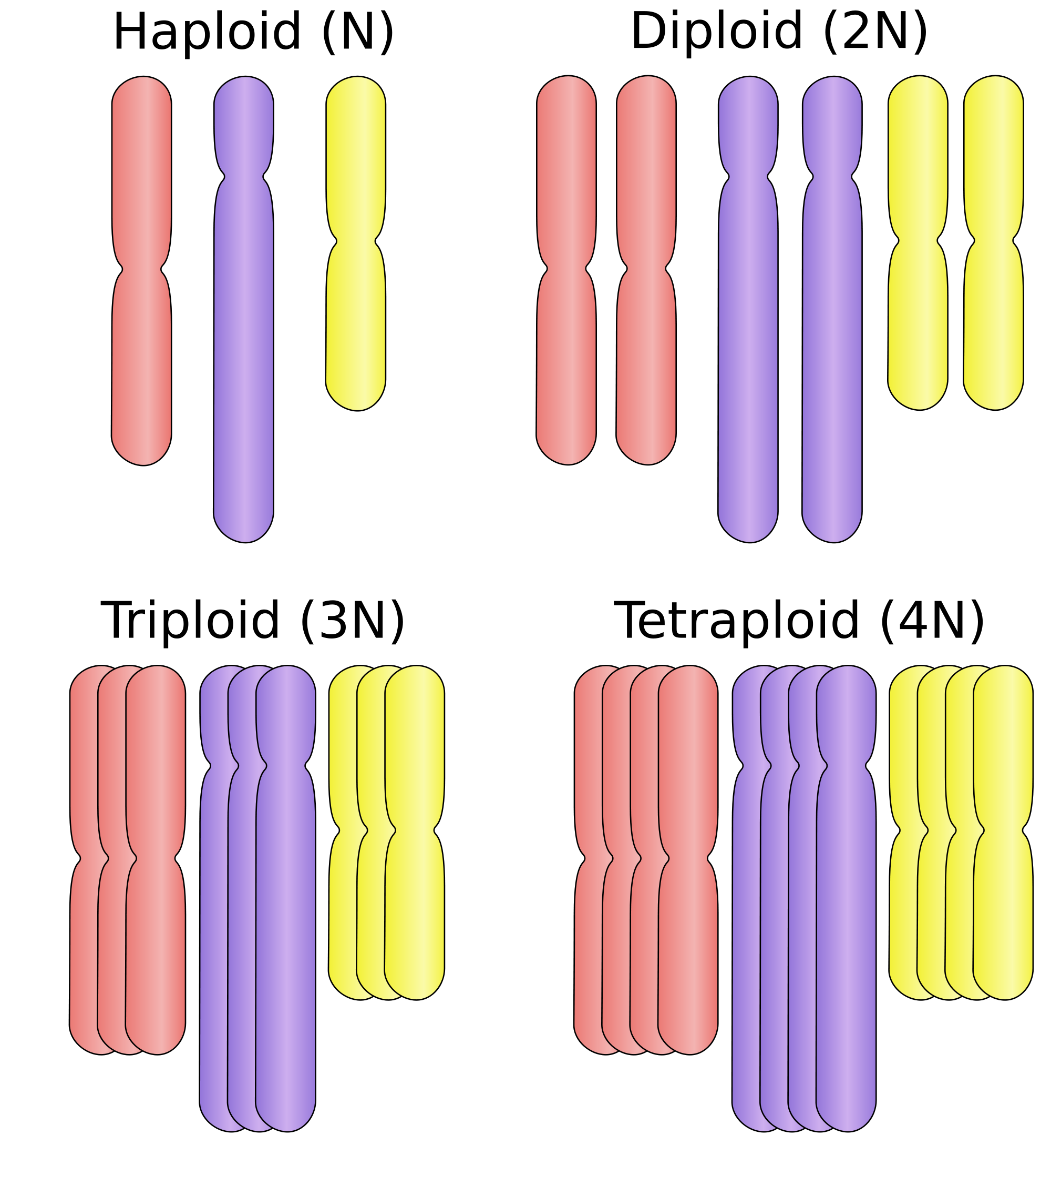
Polyploidy

Slide 8
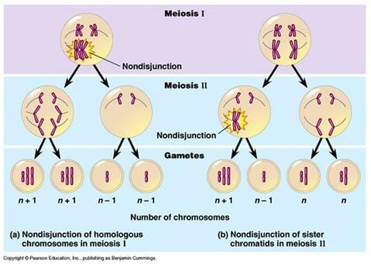
Chromosomal Disorders

Slide 9
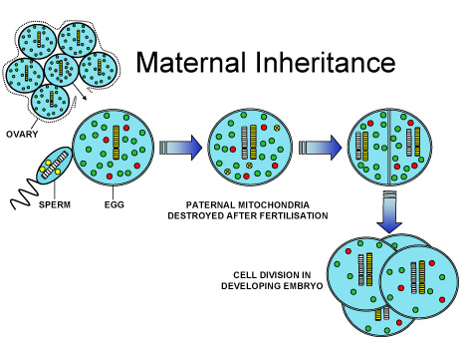
Non-Nuclear Inheritance

